Slide 1

CNSCC.203 Computer Networks Network Layer
Muhammad Azhar Iqbal
azhar.iqbal@lancaster.ac.uk
Credit goes to Dr. Matt Broadbent, Dr. Vasileios Giotsas, and Dr. Wenjuan Yu at SCC for designing module SCC.203.

Slide 2


Network Layer II: roadmap
Dynamic Host Configuration Protocol (DHCP)
Network Address Translation (NAT)
Forwarding - what’s inside a router
input ports, switching, output ports
buffer management, scheduling
Chapter 4.1, 4.2, 4.3.3, 4.3.4

Slide 3
IP addresses: how to get one?
That’s actually two questions:
Q: How does a network get IP address for itself (network part of address)
Q: How does a host get IP address within its network (host part of address)?

Slide 4
IP addresses: how to get one?
Q: how does network get subnet part of IP address?
A: gets allocated portion of its provider ISP’s address space
ISP's block 11001000 00010111 00010000 00000000 200.23.16.0/20
问:网络如何获取子网部分的IP地址?
A:获取它的提供者ISP的地址空间的分配部分
ISP can then allocate out its address space in 8 blocks:
Organization 0 11001000 00010111 00010000 00000000 200.23.16.0/23
Organization 1 11001000 00010111 00010010 00000000 200.23.18.0/23
Organization 2 11001000 00010111 00010100 00000000 200.23.20.0/23
... ….. …. ….
Organization 7 11001000 00010111 00011110 00000000 200.23.30.0/23

Slide 5
Hierarchical addressing: route aggregation
hierarchical addressing allows efficient advertisement of routing information:
分层寻址:路由聚合
分层寻址可以有效地发布路由信息
Organization 0
200.23.16.0/23
Organization 1
200.23.18.0/23
“Send me anything
with addresses
beginning
200.23.16.0/20”
Organization 2
200.23.20.0/23
.
Fly-By-Night-ISP
.
.
.
.
Internet
Organization 7
.
200.23.30.0/23
ISPs-R-Us
“Send me anything
with addresses
beginning
199.31.0.0/16”

Slide 6
IP addresses: how to get one?
That’s actually two questions:
Q: How does a network get IP address for itself (network part of address)
Q: How does a host get IP address within its network (host part of address)?

Slide 7
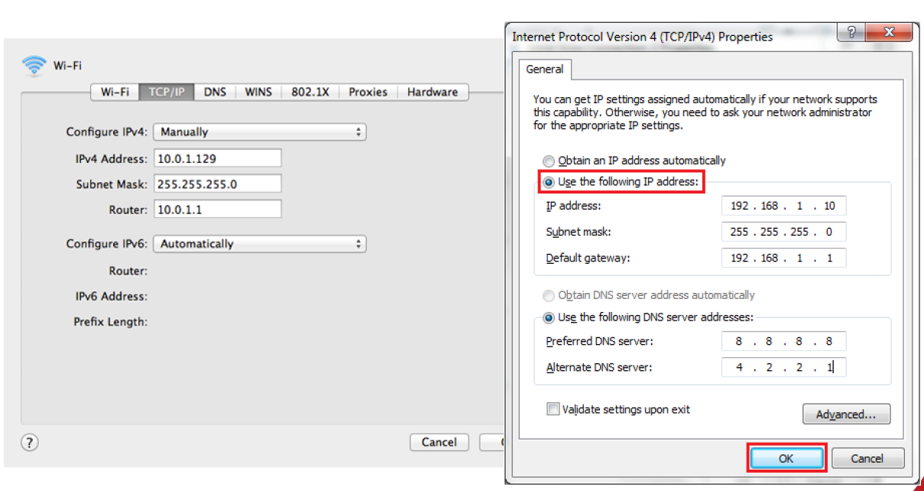
IP addresses: how to get one?
Assign an IP address to a host - Option 1: manually assignment
To many options!
How do you know if an IP address isn’t taken?
Repeat every time you connect?

Slide 8
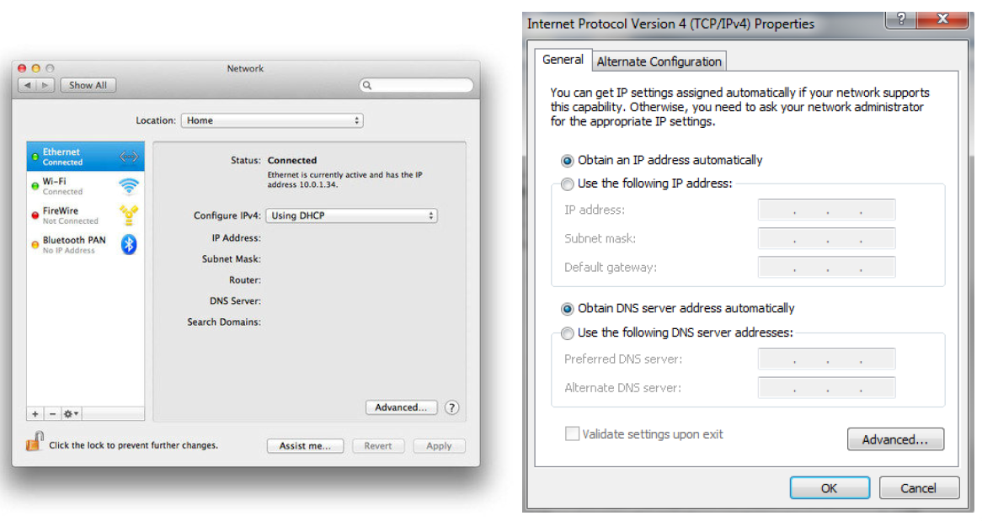
IP addresses: how to get one?
Assign an IP address to a host - Option 2: dynamic assignment
DHCP: Dynamic Host Configuration Protocol: dynamically get address from a server
为主机分配IP地址
选项1:手动分配
选项2:动态分配DHCP
动态主机配置协议:动态从服务器获取地址

Slide 9
DHCP: Dynamic Host Configuration Protocol
goal: allow host to dynamically obtain its IP address from network server when it joins network
can renew its lease on address in use
allows reuse of addresses (only hold address while connected/on)
support for mobile users who join/leave network
Plug-and-play
目标:允许主机在加入网络时从网络服务器动态获取自己的IP地址
在使用的地址上可以续租吗
允许重用地址(仅在连接时保持地址)支持加入/离开网络的移动用户
即插即用
DHCP overview:
host broadcasts DHCP discover msg [optional]
DHCP server responds with DHCP offer msg [optional]
host requests IP address: DHCP request msg
DHCP server sends address: DHCP ack msg

Slide 10
DHCP Background
Allows a host to join an IP network without having a pre-configured IP address
Runs over UDP/ IP
Temporarily binds IP address and other parameters to DHCP client
Provides framework for passing configuration information to hosts
DHCP assigns a unique IP address
Simplifies installation and configuration of end systems
Allows for manual and automatic IP address assignment
May provide additional configuration information
Local DNS server, subnet mask, default router, etc.
Used by
ISPs to minimise set-up costs
LANs and organisational networks
允许主机无需预先配置IP地址即可加入IP网络
运行UDP/ IP协议
DHCP客户端临时绑定IP地址等参数
提供向主机传递配置信息的框架
DHCP分配唯一的IP地址
简化终端系统的安装和配置
手动和自动分配IP地址
可能提供附加配置信息．本地DNS服务器，子网掩码，默认路由器等

Slide 11




DHCP client-server scenario
DHCP server
223.1.1.1
223.1.2.1
223.1.2.5
223.1.1.2
223.1.1.4
223.1.2.9
223.1.1.3
223.1.3.27
arriving DHCP client needs
address in this network
223.1.2.2
通常情况下，在家庭网络中，DHCP服务器位于路由器中
223.1.3.1
223.1.3.2
Typically, on home networks, DHCP server is co-located in the router

Slide 12


DHCP client-server scenario
DHCP server: 223.1.2.5
DHCP discover
Arriving client
src : 0.0.0.0, 68
dest.: 255.255.255.255,67
yiaddr: 0.0.0.0
transaction ID: 654
Broadcast: is there a DHCP server out there?
DHCP offer
src: 223.1.2.5, 67
dest: 255.255.255.255, 68
yiaddrr: 223.1.2.4
transaction ID: 654
lifetime: 3600 secs
Broadcast: I’m a DHCP server! Here’s an IP address you can use
The two steps above can be skipped “if a client remembers and wishes to reuse a previously allocated network address” [RFC 2131]
DHCP request
src: 0.0.0.0, 68
dest:: 255.255.255.255, 67
yiaddrr: 223.1.2.4
transaction ID: 655
lifetime: 3600 secs
Broadcast: OK. I would like to use this IP address!
DHCP ACK
src: 223.1.2.5, 67
dest: 255.255.255.255, 68
yiaddrr: 223.1.2.4
transaction ID: 655
lifetime: 3600 secs
Broadcast: OK. You’ve got that IP address!

